Slide 1
‘Busy’ Record, Put-callback Support
Kay Kasemir
Feb. 2022

Slide 2
Basic Automation Example
Has the motor reached the position?
Move motor to some position
Open shutter
Take data for 5 seconds
Close shutter
How quickly does the shutter open?

Slide 3
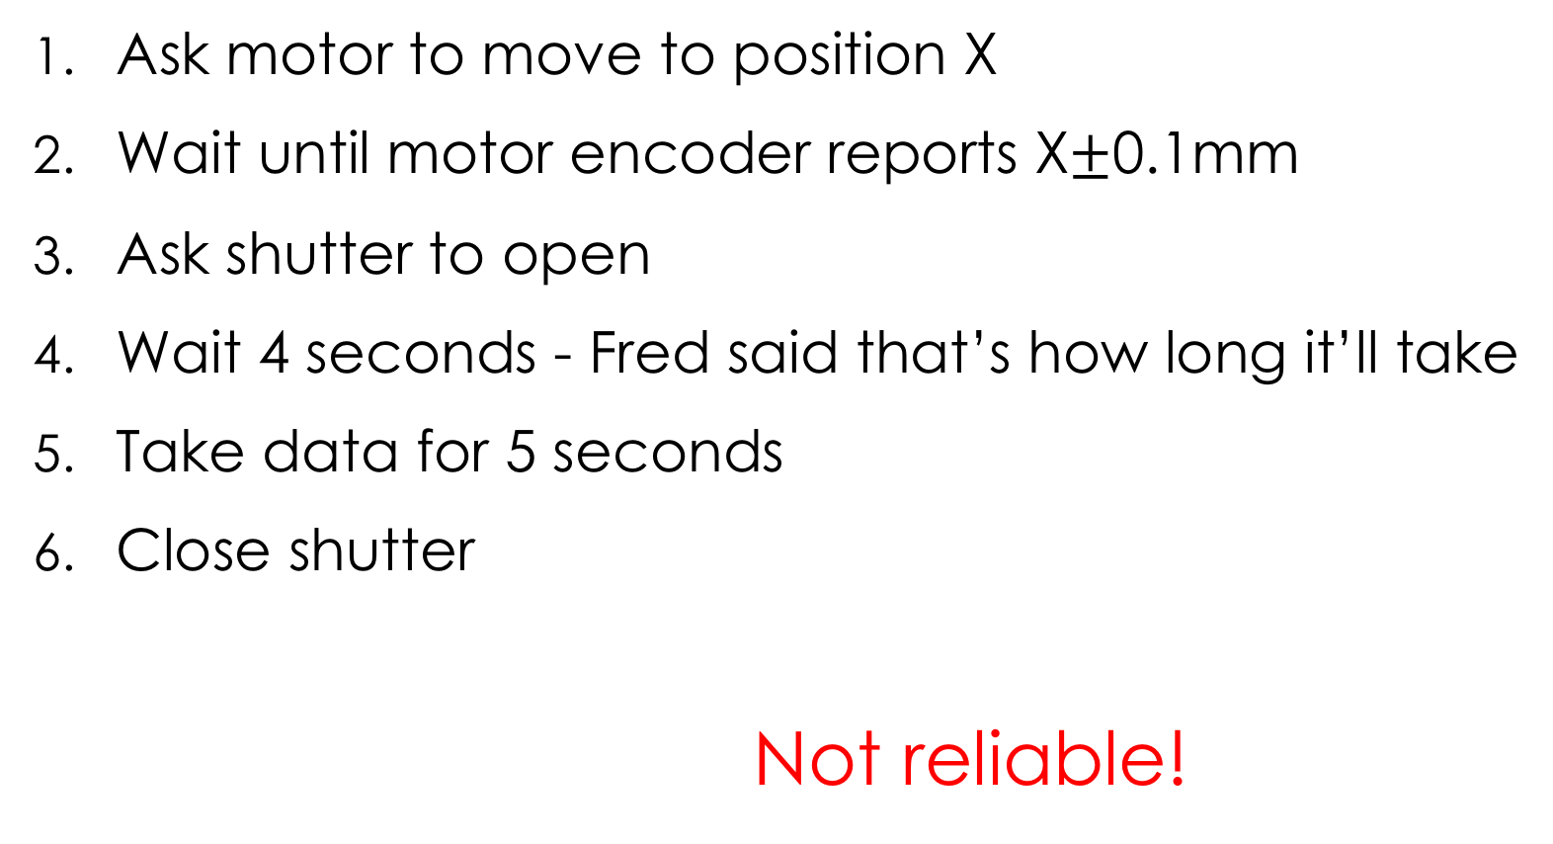
What not to do
Ask motor to move to position X
Wait until motor encoder reports X$±$0.1mm
Ask shutter to open
Wait 4 seconds - Fred said that’s how long it’ll take
Take data for 5 seconds
Close shutter
Not reliable!

Slide 4
Based on readback, are we done?
Temperature,
Position,
…
Setpoint
Readback
done?
done?
done!
Time

Slide 5
IOC has to tell us when it’s done
Use CA “put-callback”
Record completes callback when its “done”
Requires record with support for “completion” aka “put-callback”
Motor record: When reaching desired position
General record: Check device support manual
Plain database: Use BUSY record

Slide 6
EPICS record PACT field
PACT is binary flag that is 1 (ON) when record is processing
CA put-callback is mechanism to use PACT information…
…and not return until PACT is 0 (OFF)
caput -c -w <timeout> <PV>

Slide 7
BUSY record
VAL = 1 ”Busy”, VAL=0 “Done”
Blocks processing (PACT=1) while busy
More records,
or SNL code
Record A
Busy record
VAL=1
caput –c …
write
Link
Record A
Busy record
VAL=0
caput –c …
done
done

Slide 8
Typical Use
Writing to some record, which has FLNK or OUT links to a busy record, sets the busy.VAL = 1
This causes writer to that first record to block in put-callback
Something else resets busy.VAL = 0
  Other database logic
  Sequencer code
  asyn device support
  …
Put-callback completes

Slide 9
Put-Callback
.. Is essential for robust automation
Use BUSY record to create database logic that supports put-callback

